Slide 1
Assignment 5
Marissa Defratti

Slide 2
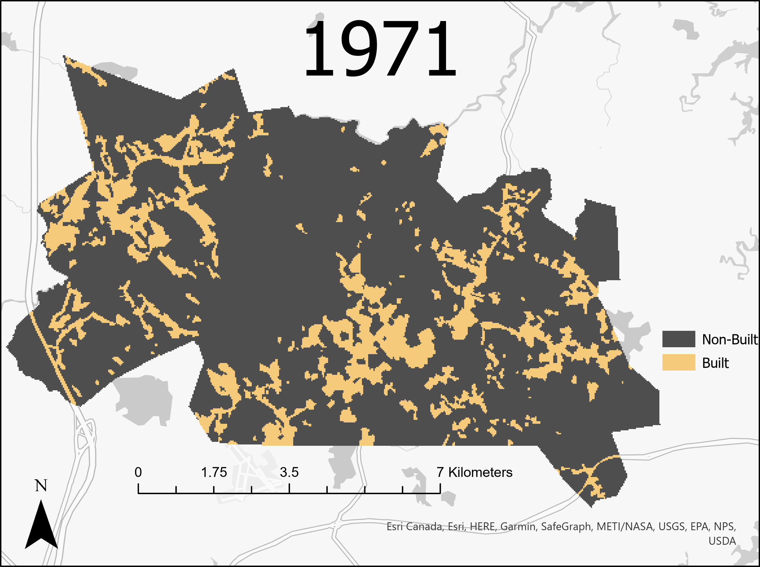
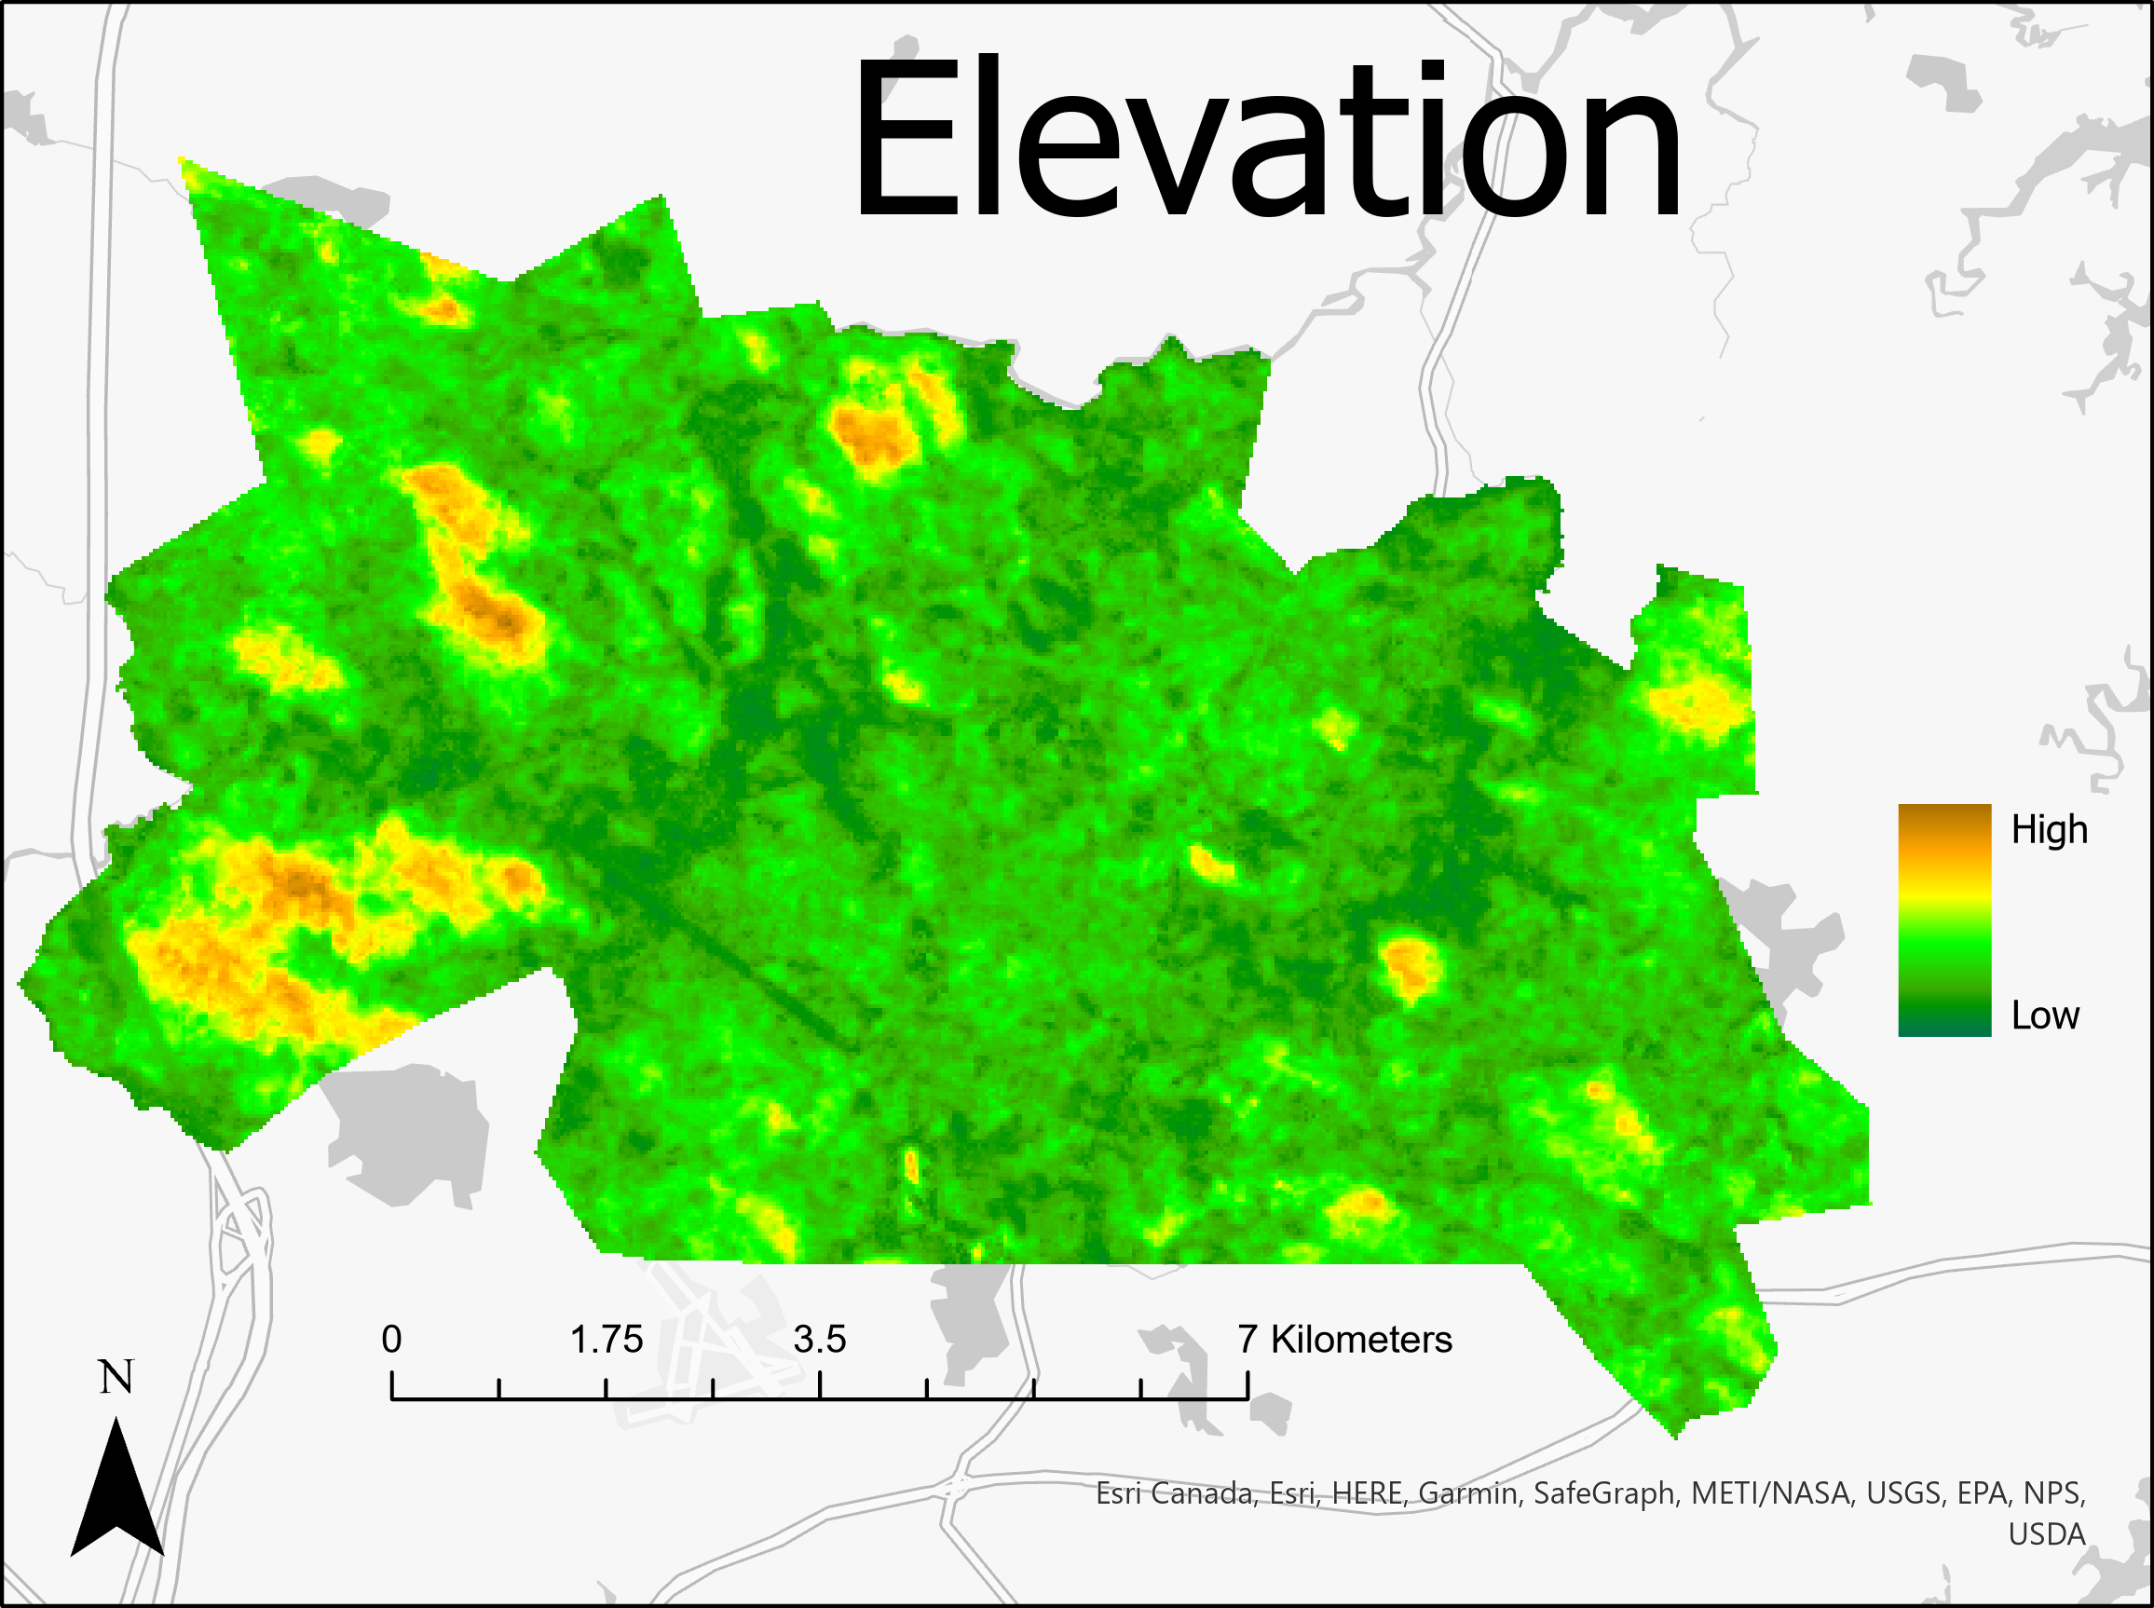
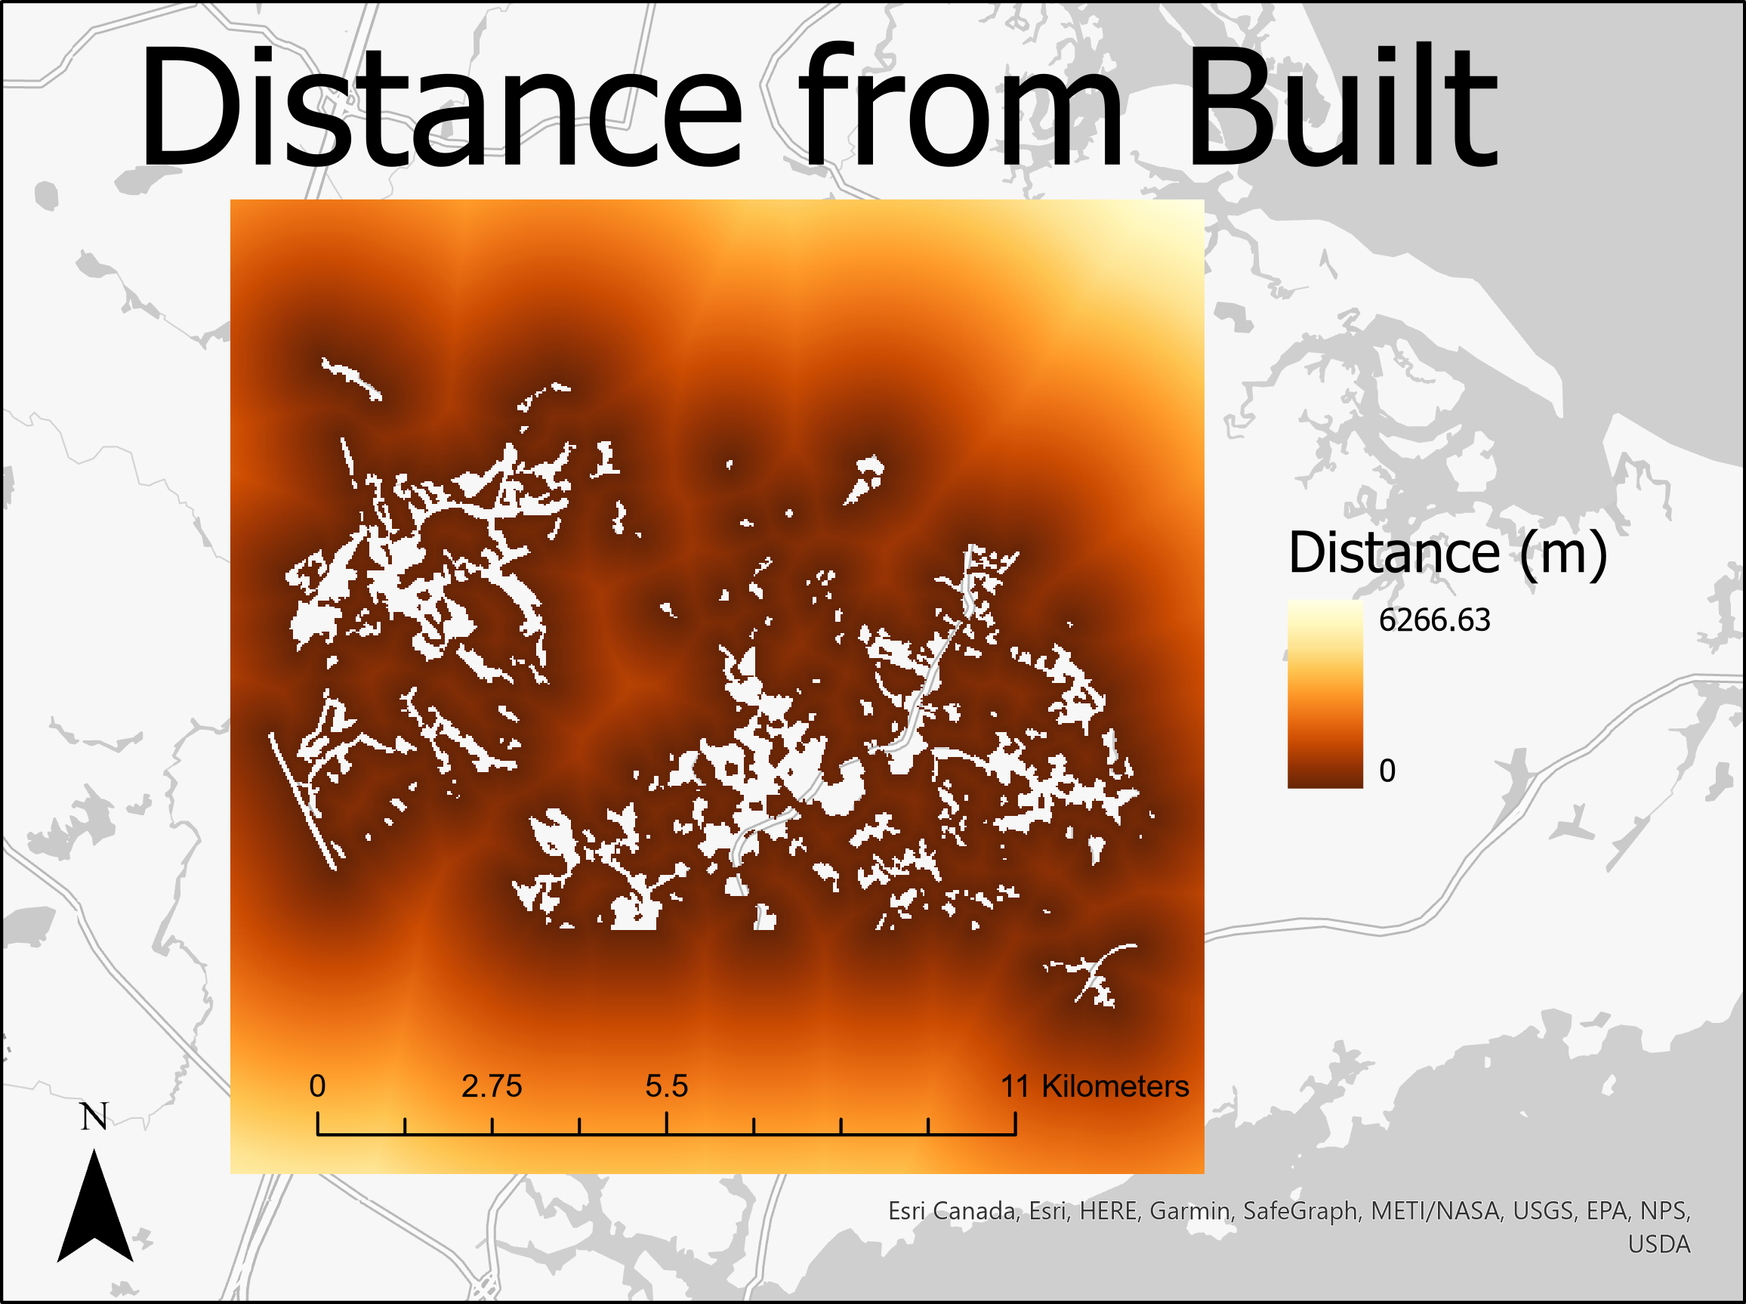
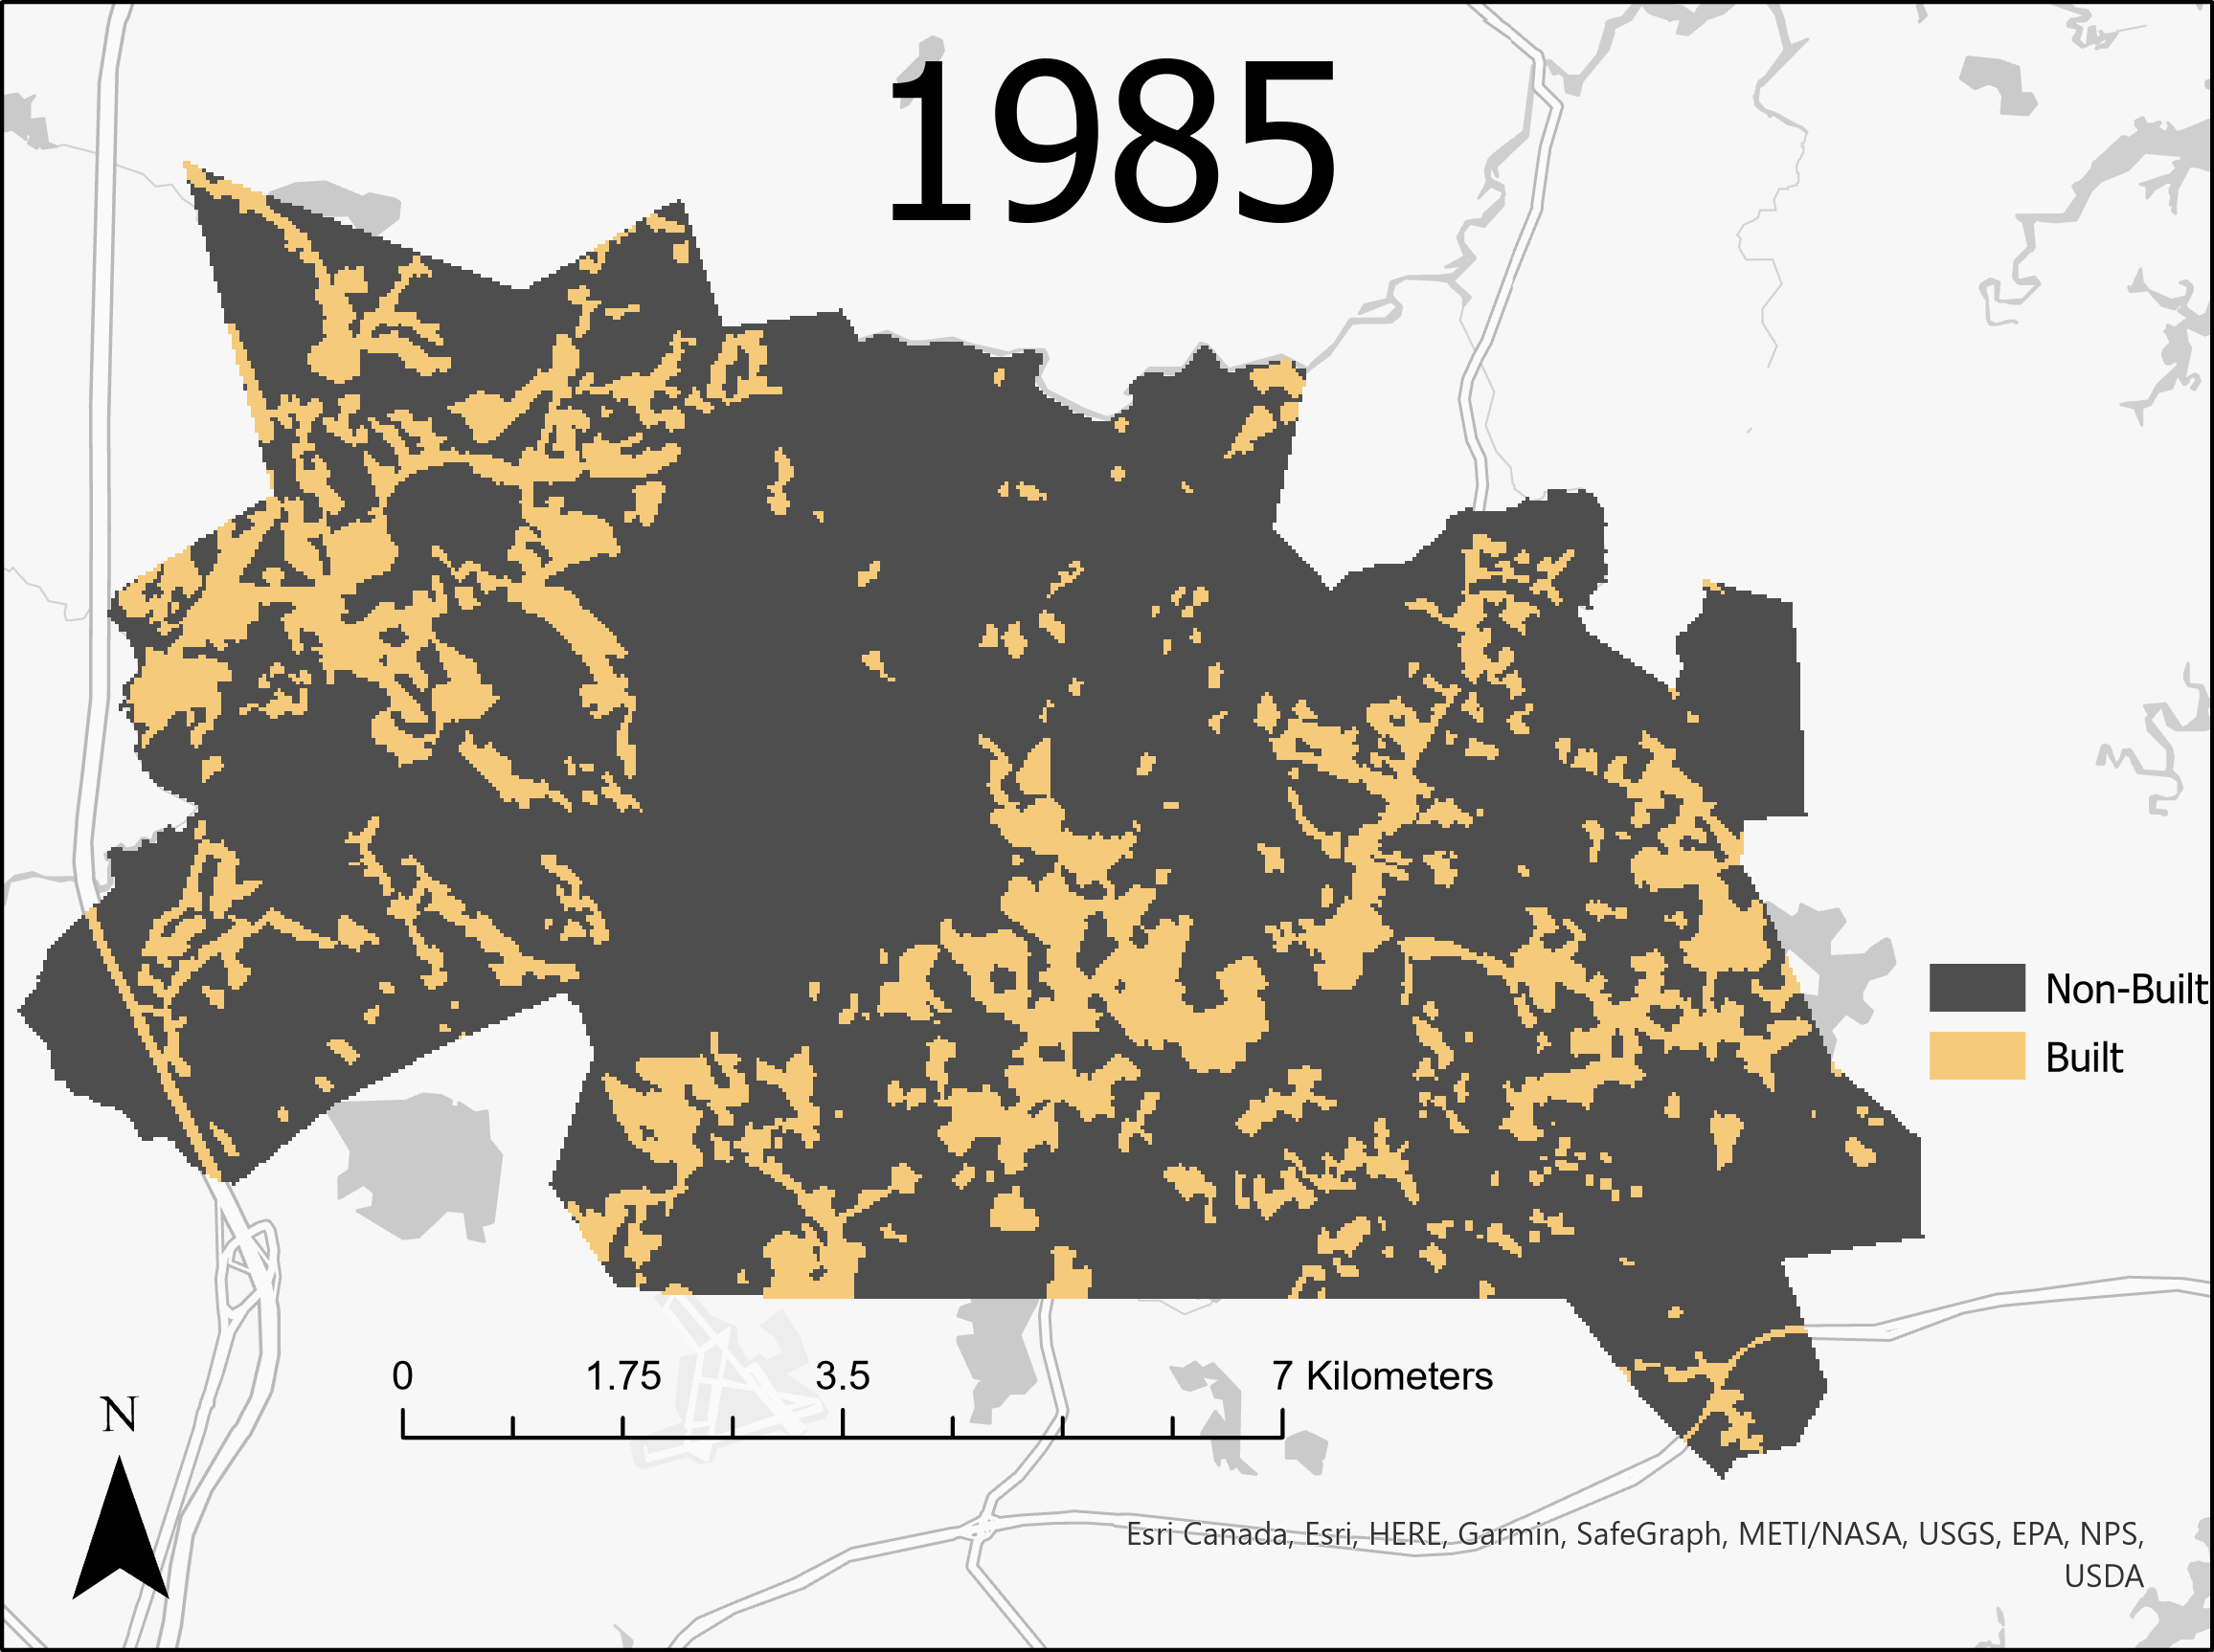
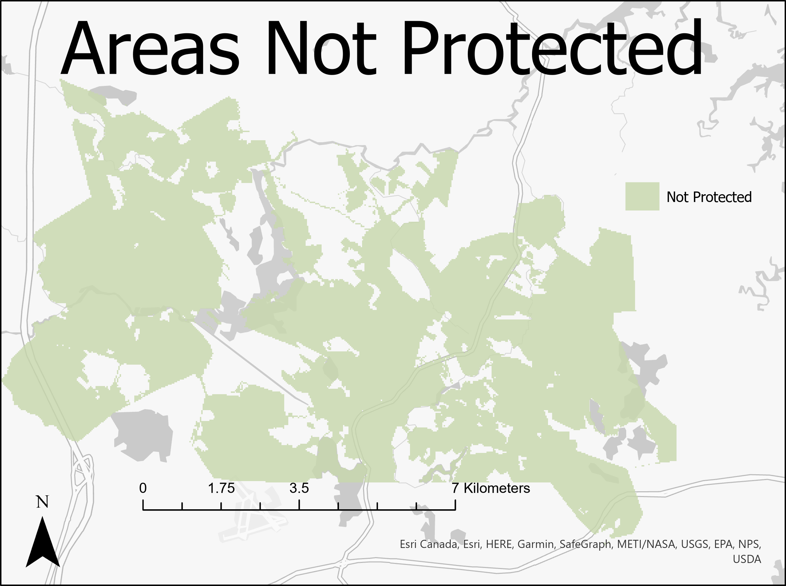
Input Maps
Notes:
Input maps (earlier image, later image, independent variable of distance, independent variable of elevation, Boolean protection map)

Slide 3
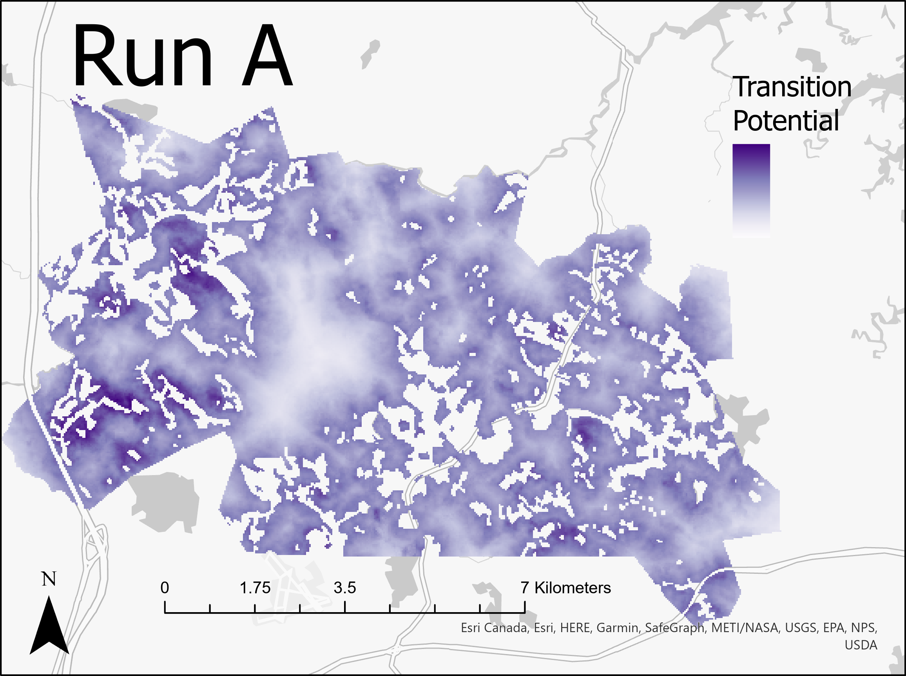
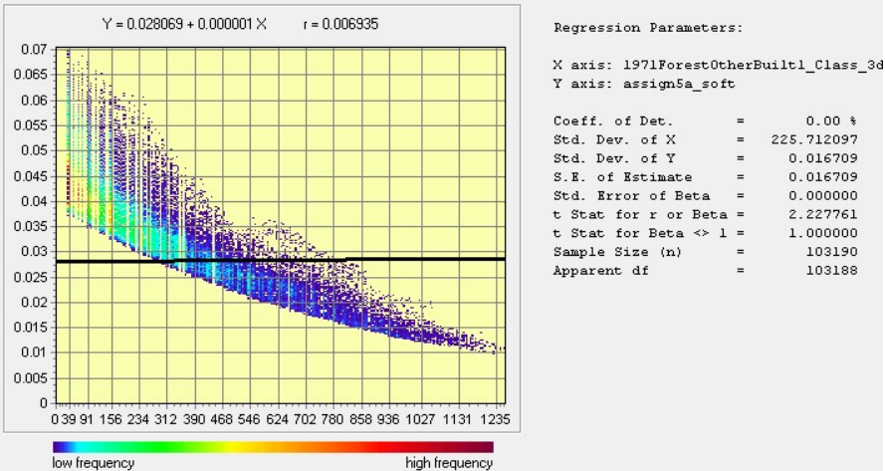
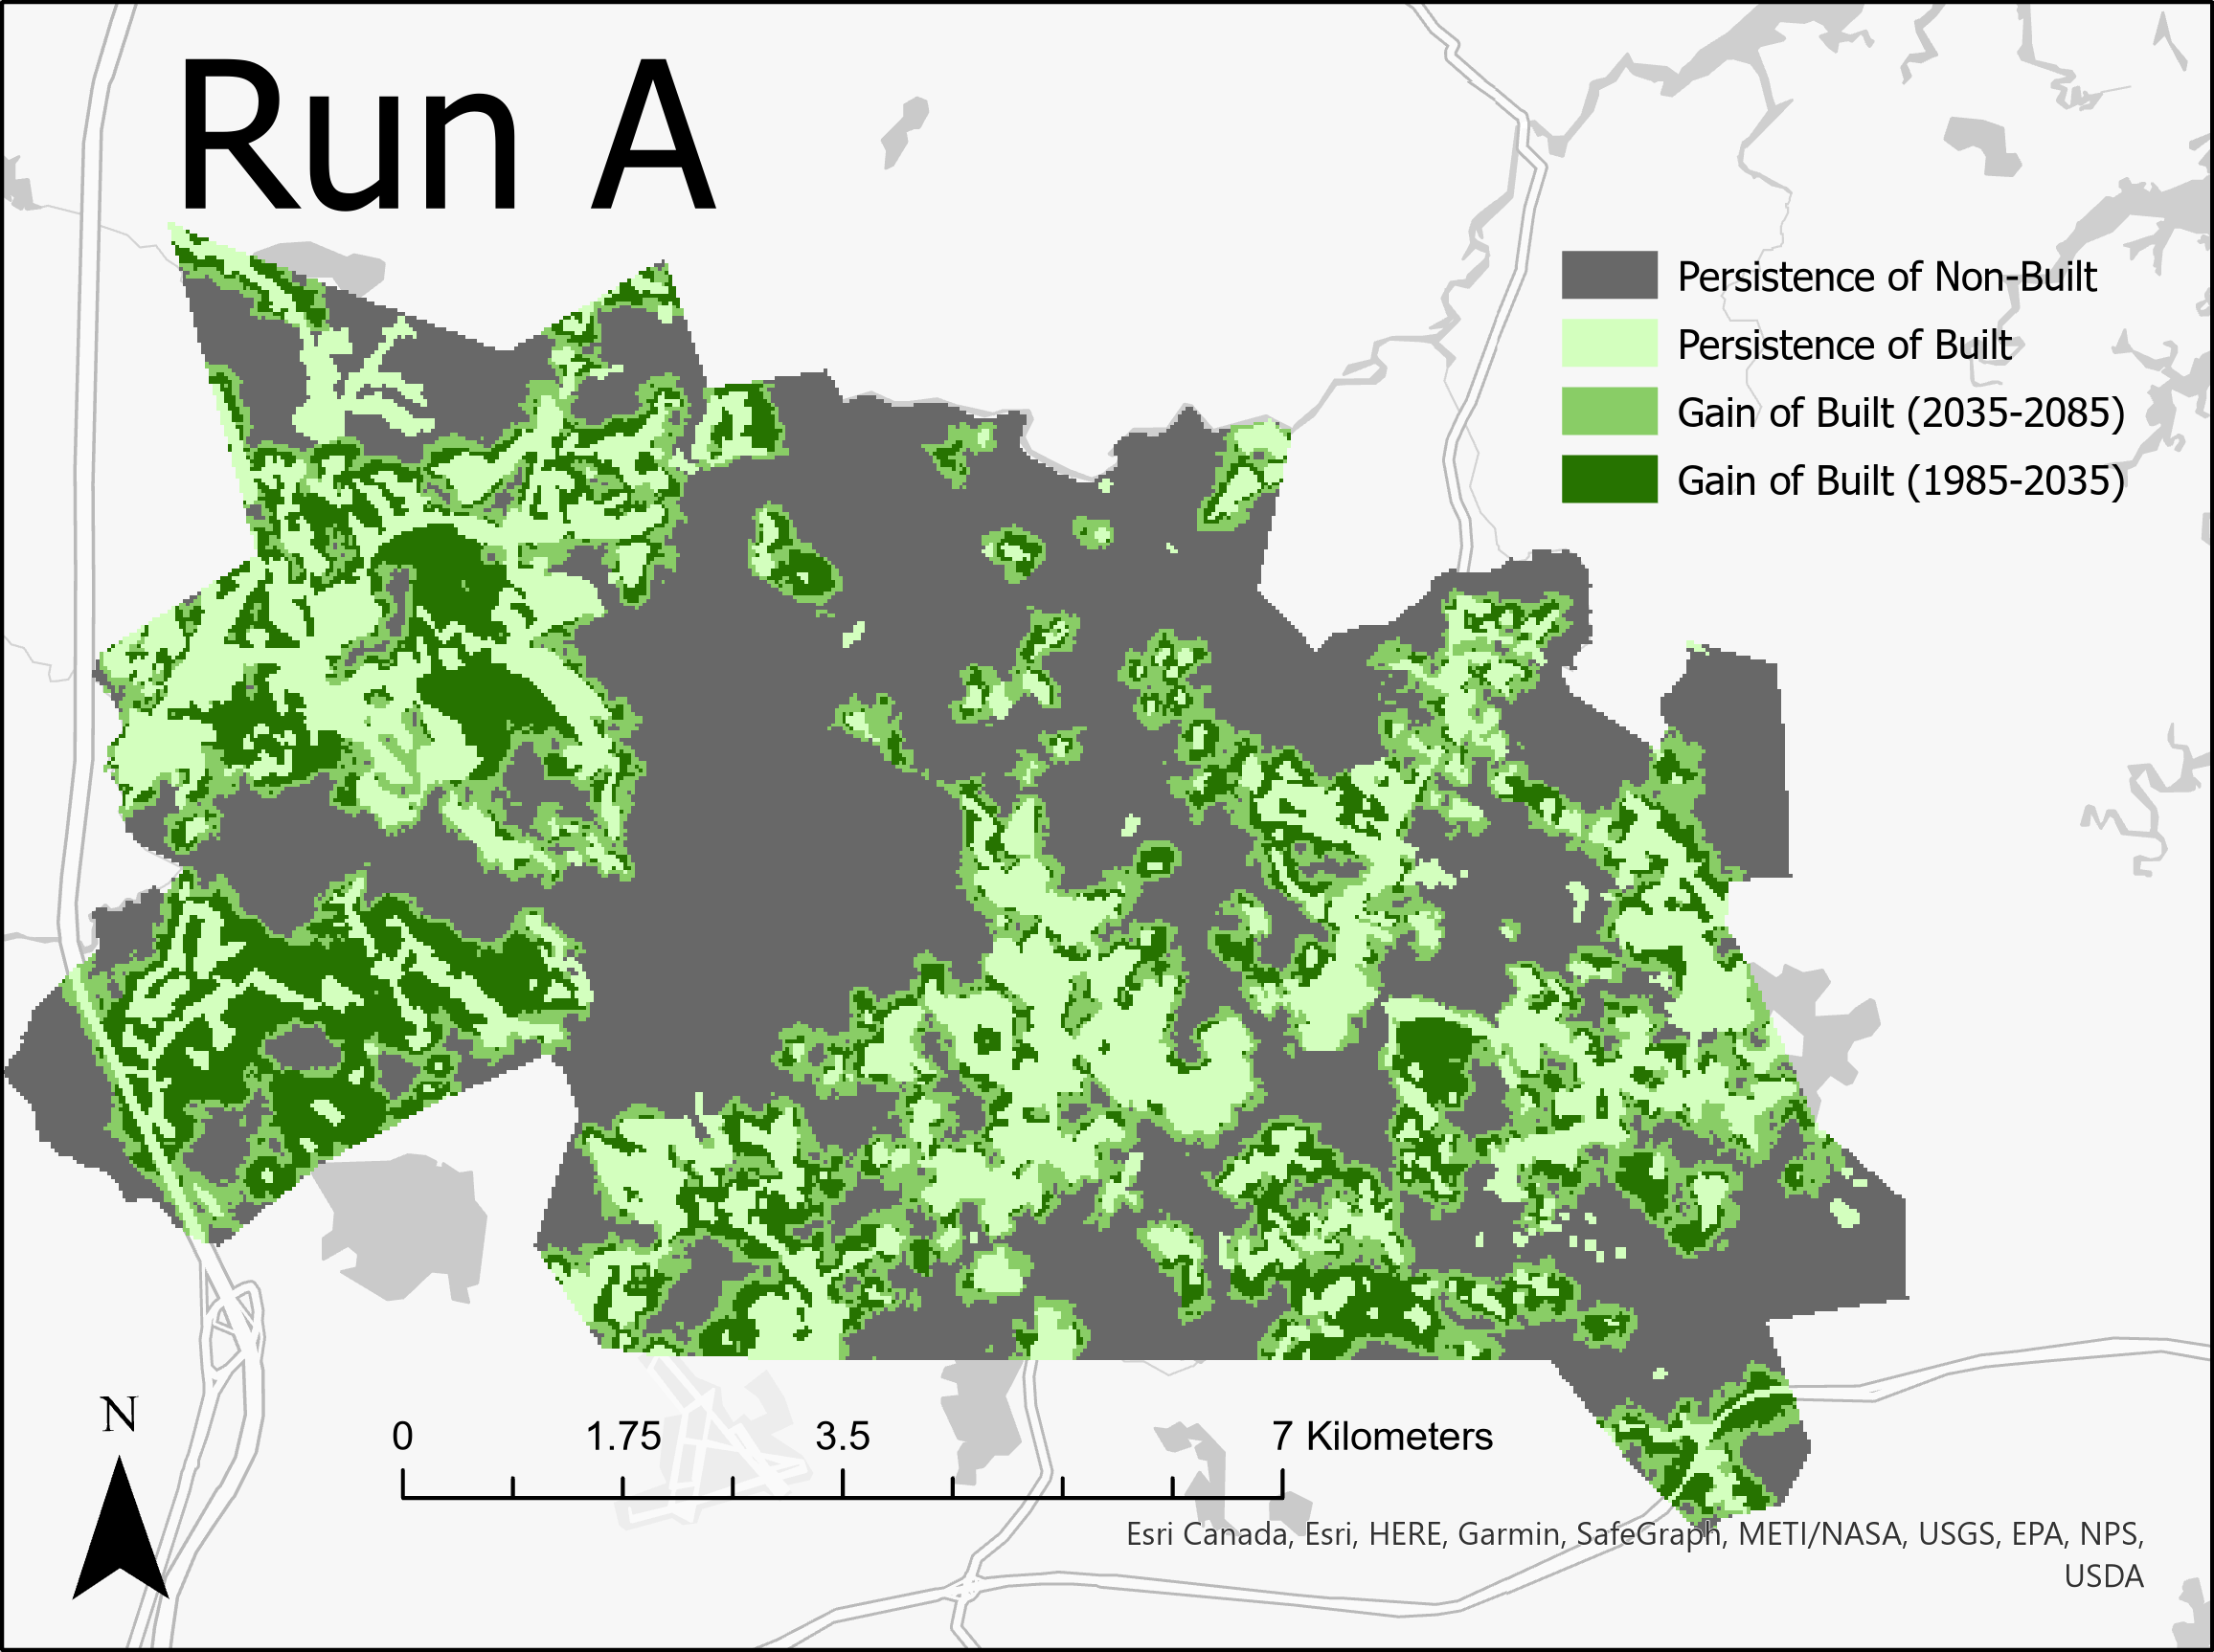
Run A
Category | Pixels
Persistence of Non-Built | 48,547
Persistence of Built | 22,279
Gain of Built (2035-2085) | 16,182
Gain of Built (1985-2035) | 16,182
Notes:
RunA Analysis: (soft output map, CROSSTAB map, Regress ScatterPlot)
Explain: # of pixels of gain during each stage & why;
How LCM uses transition potential map;
Avg. transition potential for each soft prediction map;
Does a large avg. transition potential lead to an increase risk of larger quantity of post-1985 gain of built?

Slide 4

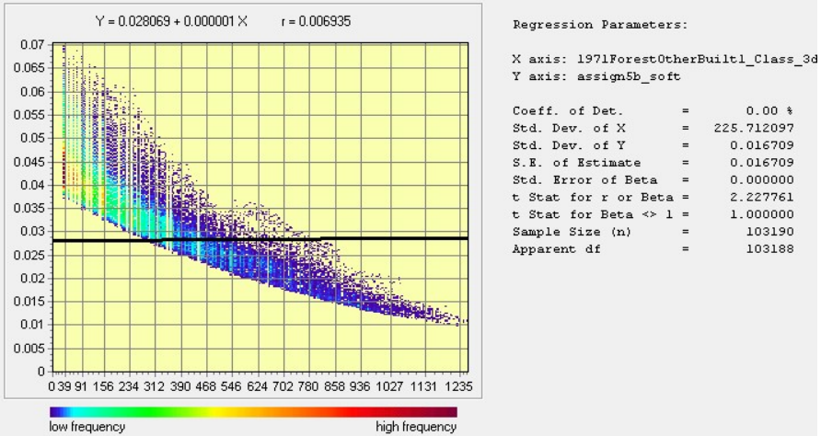
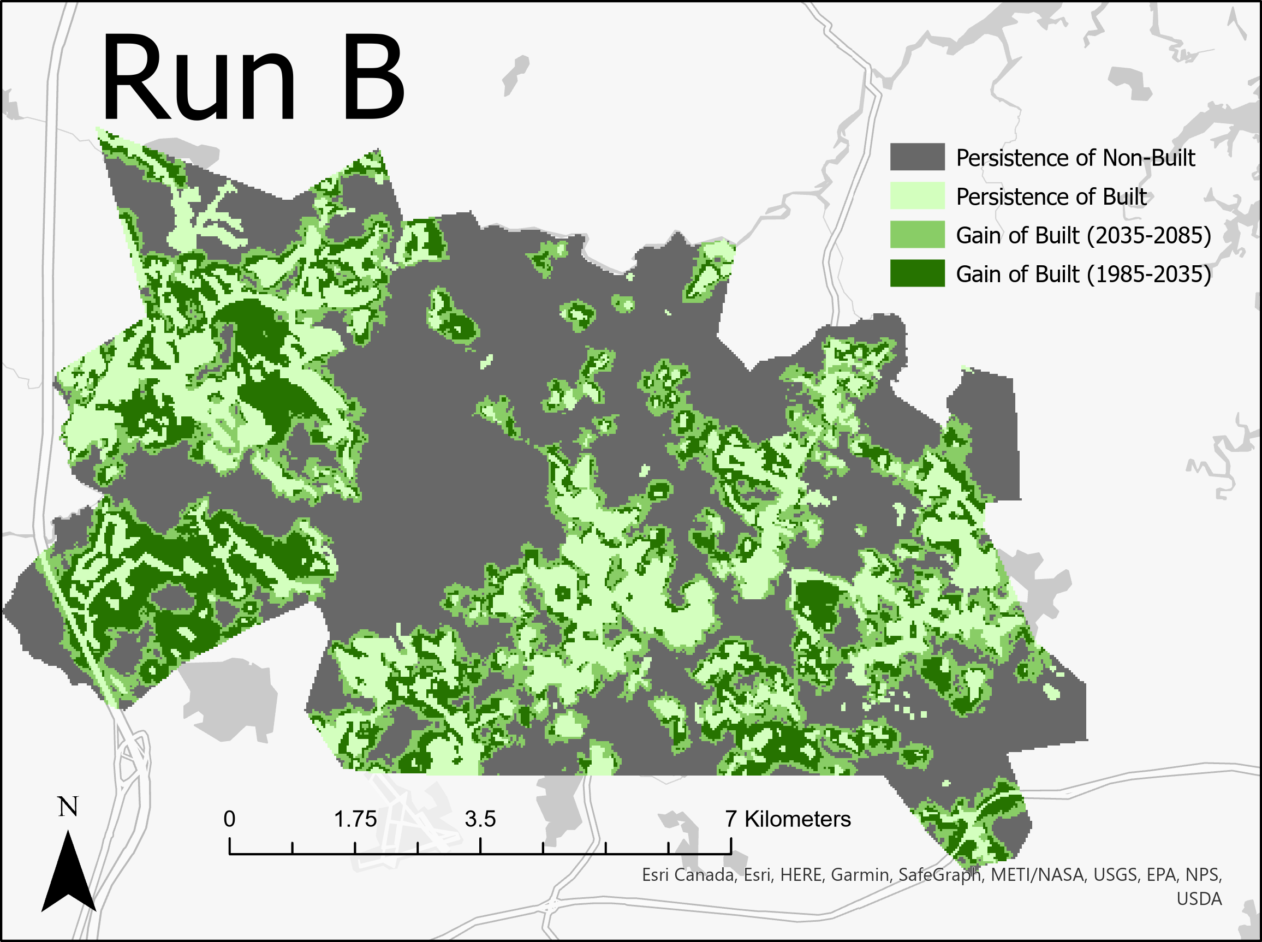
Run B
Category | Pixels
Persistence of Non-Built | 48,547
Persistence of Built | 22,279
Gain of Built (2035-2085) | 16,182
Gain of Built (1985-2035) | 16,182
Notes:
RunB Analysis: (soft output map, CROSSTAB map, Regress ScatterPlot)
Explain: # of pixels of gain during each stage & why;
How LCM uses transition potential map;
Avg. transition potential for each soft prediction map;
Does a large avg. transition potential lead to an increase risk of larger quantity of post-1985 gain of built?

Slide 5
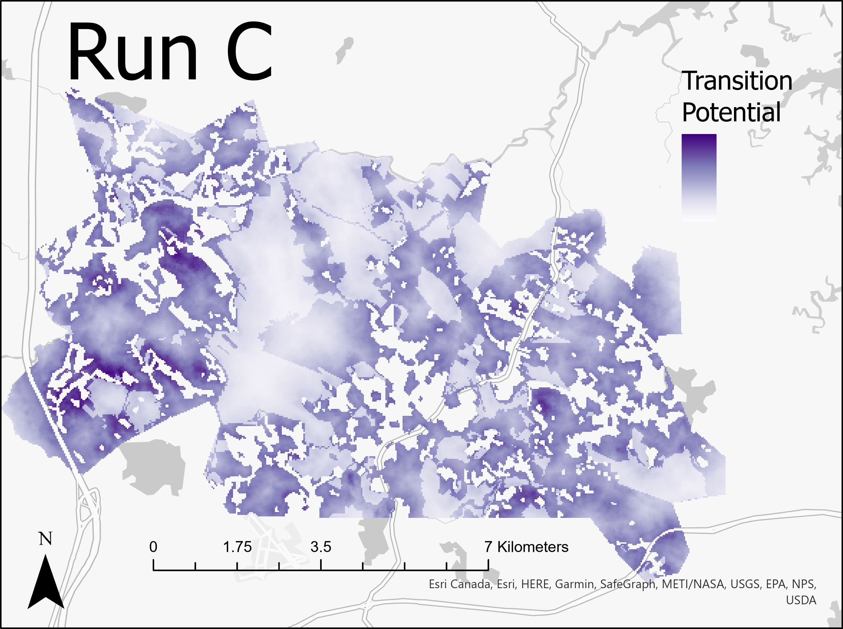
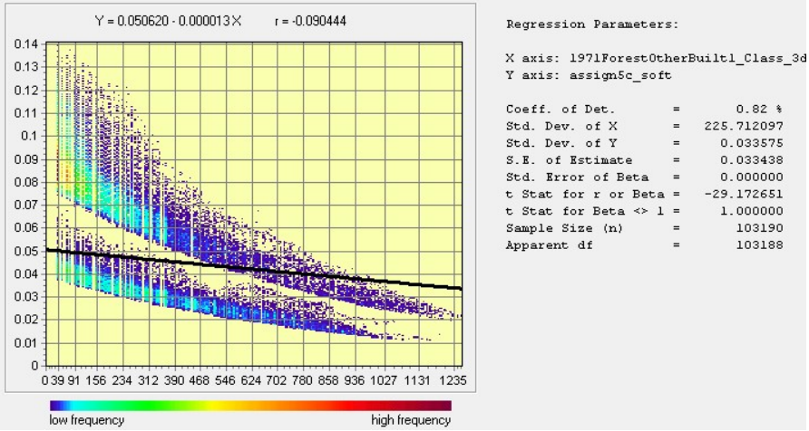

Run C
Category | Pixels
Persistence of Non-Built | 48,547
Persistence of Built | 22,279
Gain of Built (2035-2085) | 16,182
Gain of Built (1985-2035) | 16,182
Notes:
RunA Analysis: (soft output map, CROSSTAB map, Regress ScatterPlot)
Explain: # of pixels of gain during each stage & why;
How LCM uses transition potential map;
Avg. transition potential for each soft prediction map;
Does a large avg. transition potential lead to an increase risk of larger quantity of post-1985 gain of built?

